Slide 1
Machine Learning DASC 522
Classical Selection & Regularization
Dr. Torrey Wagner

Slide 2
Overview
Big Picture & Introduction
Classical Selection
Best Subset Selection
Stepwise Selection (forward/backward/hybrid)
Error Analysis (C_{p}, adj R², AIC, BIC, Validation, Cross-validation)
Classical Regularization (a.k.a. shrinkage)
L₁ Regularization (a.k.a. Lasso Regression)
L₂ Regularization (a.k.a. Ridge Regression)
More dimension reduction
PCA → PCR (unsupervised)
Partial Least Squares (supervised)

Slide 3
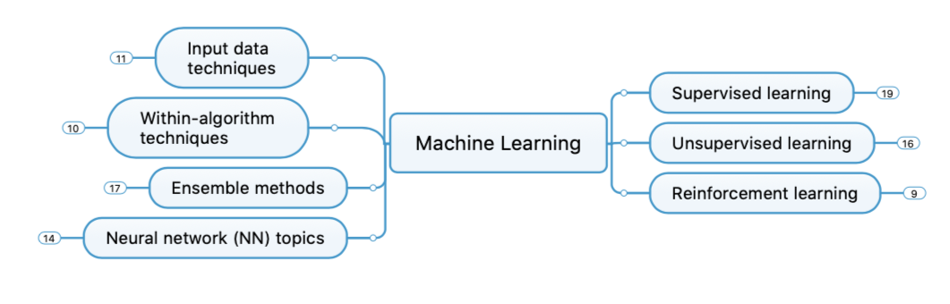
Big Picture - Concept Map

Slide 4
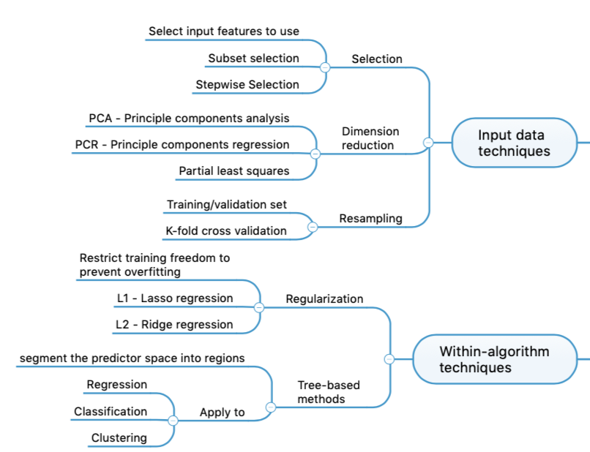
Big Picture - Concept Map

Slide 5
Why select features for our model?
Given a set of observations, in Linear Regression, the cost can be expressed as MSE or RSS or R²
Least-squares fitting picks coefficients that minimize this cost
There are 2 reasons that coefficients selected using these cost estimates may not be ideal:
Prediction Accuracy on non-training data
Model Interpretability for features
Slide from Dr. Brett Borghetti, AFIT/ENG CSCE 623 Statistical Machine Learning course, 2019SP

Slide 6
Prediction Accuracy Problems
The Linear Regression estimate has low variability especially when the relationship between Y and X is linear and the number of observations n is much larger than the number of predictors p
But, when , then the fit can have high variance and may result in overfitting and poor estimates on unseen observations – poor generalizability
And, when , then the variability of fit increases dramatically, and the variance of these estimates are unacceptable
Slide from Dr. Brett Borghetti, AFIT/ENG CSCE 623 Statistical Machine Learning course, 2019SP

Slide 7
Other High-Dimensional Problems
When we have a large number of features in the model there will be many that have little or no influence on Y
Leaving these variables in the model makes it harder to determine “important variables”
The model would be easier to interpret by removing the unimportant variables
Slide from Dr. Brett Borghetti, AFIT/ENG CSCE 623 Statistical Machine Learning course, 2019SP

Slide 8
Solutions
Subset Selection
Identify a subset of all p predictors which best predict the response Y, and then fit the model using only this subset
Methods: best subset selection and stepwise selection
Regularization through coefficient Shrinkage
Penalize the model (new cost function element) for having non-zero estimates of coefficients -> pushes coefficients towards zero
This shrinkage reduces the variance WHY?
Some of the coefficients may shrink to exactly zero – helps with variable selection/interpretation
Methods: Ridge regression and the LASSO
Dimension Reduction
Project all p predictors into an M-dimensional space where M < p, and then fit a linear regression model
Example: Principle Components Regression
Slide from Dr. Brett Borghetti, AFIT/ENG CSCE 623 Statistical Machine Learning course, 2019SP

Slide 9
Overview
Big Picture & Introduction
Classical Selection
Best Subset Selection
Stepwise Selection (forward/backward/hybrid)
Error Analysis (C_{p}, adj R², AIC, BIC, Validation, Cross-validation)
Classical Regularization (a.k.a. shrinkage)
L₁ Regularization (a.k.a. Lasso Regression)
L₂ Regularization (a.k.a. Ridge Regression)
More dimension reduction
PCA → PCR (unsupervised)
Partial Least Squares (supervised)

Slide 10
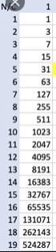
6.6.1 Best Subset Selection
Fit a linear regression model for each possible combination of the X predictors
How do we judge which subset is the “best”?
One simple approach is to take the subset with the smallest RSS or the largest R²
Unfortunately, one can show that the model that includes all the variables will always have the largest R² (and smallest RSS)
Slide from Dr. Brett Borghetti, AFIT/ENG CSCE 623 Statistical Machine Learning course, 2019SP

Slide 11
Credit Data: R² vs. Subset Size
RSS will never increase (and R² will never decrease) as the number of variables increase - not very useful
Grey dots – actual performance of various subset models
red line: the best model for a given number of predictors, according to RSS and R²
Slide from Dr. Brett Borghetti, AFIT/ENG CSCE 623 Statistical Machine Learning course, 2019SP

Slide 12
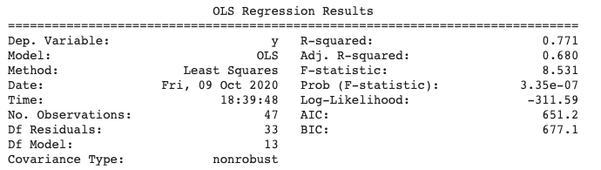
Measures for Estimating model Performance on unseen data from training data fit
To compare different models, adjust the RSS of the training data model fit based on some penalty for number of features
Adjusted R²
AIC (Akaike information criterion)
BIC (Bayesian information criterion)
C_{p} (Mallow’s C_{p}: Proportional to AIC)
These methods add penalty to RSS for the number of variables (i.e. complexity) in the model
Slide adapted from Dr. Brett Borghetti, AFIT/ENG CSCE 623 Statistical Machine Learning course, 2019SP

Slide 13
Credit Data: C_{p}, BIC, and Adjusted R²
A small value of C_{p} or BIC indicates a low error, and thus (hopefully) a better model
A large value for the Adjusted R² indicates a better model
Slide adapted from Dr. Brett Borghetti, AFIT/ENG CSCE 623 Statistical Machine Learning course, 2019SP

Slide 14
Python Demo
Best Subset Selection

Slide 15
Overview
Big Picture & Introduction
Classical Selection
Best Subset Selection
Stepwise Selection (forward/backward/hybrid)
Classical Regularization (a.k.a. shrinkage)
L₁ Regularization (a.k.a. Lasso Regression)
L₂ Regularization (a.k.a. Ridge Regression)
More dimension reduction
PCA → PCR (unsupervised)
Partial Least Squares (supervised)

Slide 16
Feature Selection via Stepwise Selection
Best Subset Selection is computationally intensive especially when we have a large number of predictors (large p)
More computationally-attractive methods:
Forward Stepwise Selection: Begins with the model containing no predictor, and then adds one predictor at a time that improves the model the most until no further improvement occurs
Backward Stepwise Selection: Begins with the model containing all predictors, and then deleting one predictor at a time where the predictor chosen at each step is the feature that causes the least degradation to model performance when removed.
Slide from Dr. Brett Borghetti, AFIT/ENG CSCE 623 Statistical Machine Learning course, 2019SP

Slide 17
Python Functions
Python - SelectKBest
Only for classification
Python - Recursive Feature Elimination (RFE)
Example of BSS
Given an external estimator that assigns weights to features (e.g., the coefficients of a linear model)…
…the goal of RFE is to select k features by recursively considering smaller and smaller sets of features.
RFE Steps
First, the estimator is trained on the initial set of features and the importance of each feature is obtained
Then, the least important features are pruned from current set of features.
Repeat on the pruned set until k is reached.

Slide 18
Python Demo
Recursive Feature Elimination

Slide 19
Overview
Big Picture & Introduction
Classical Selection
Best Subset Selection
Stepwise Selection (forward/backward/hybrid)
Classical Regularization (a.k.a. shrinkage)
L₂ Regularization (a.k.a. Ridge Regression)
L₁ Regularization (a.k.a. Lasso Regression)
More dimension reduction
PCA → PCR (unsupervised)
Partial Least Squares (supervised)

Slide 20
Big Picture - Concept Map

Slide 21
Bias & Variance in Linear Modeling
Ordinary Least Squares (OLS) regression is known to give unbiased results with low variance as compared to non linear models.
Ridge (OLS with L2 penalty) & Lasso (OLS with L1 penalty)
give biased results with lower variance as compared to OLS.
https://towardsdatascience.com/bias-and-variance-in-linear-models-e772546e0c30

Slide 22
6.2.1 Ridge Regression (L2)
Ordinary Least Squares (OLS) estimates by minimizing
Ridge Regression uses a slightly different minimization equation which adds a term…
Slide from Dr. Brett Borghetti, AFIT/ENG CSCE 623 Statistical Machine Learning course, 2019SP

Slide 23
Ridge Regression Adds a Penalty on
The effect of this equation is to add a penalty of the form
Where the tuning parameter is a positive value.
This has the effect of “shrinking” large values of towards zero.
This penalty should improve the fit because shrinking the coefficients can significantly reduce their variance
When = 0, we get the original RSS from Ordinary Least Squares
Slide from Dr. Brett Borghetti, AFIT/ENG CSCE 623 Statistical Machine Learning course, 2019SP

Slide 24
Credit Data: Ridge Regression
As increases, the standardized coefficients shrinks towards zero.
Will coefficients ever reach zero?
Slide from Dr. Brett Borghetti, AFIT/ENG CSCE 623 Statistical Machine Learning course, 2019SP

Slide 25
Why can shrinking towards zero be a good thing to do?
When n and p are of similar size or when n < p, then the OLS estimates will be extremely variable. It turns out that the parameter estimates generally have low bias but can be highly variable.
The penalty term makes the ridge regression estimates biased but can also substantially reduce variance
Thus, there is a bias / variance trade-off
Slide from Dr. Brett Borghetti, AFIT/ENG CSCE 623 Statistical Machine Learning course, 2019SP

Slide 26
Ridge Regression Bias / Variance
Black: MSE due to Bias
Green: MSE due to Variance
Purple: MSE ~ Bias+Variance
Increase in increases bias but decreases variance
Slide from Dr. Brett Borghetti, AFIT/ENG CSCE 623 Statistical Machine Learning course, 2019SP

Slide 27
Bias / Variance Trade-off
In general, the ridge regression estimates will be more biased than the OLS ones but have lower variance
Ridge regression will work best in situations where the OLS estimates have high variance
Slide from Dr. Brett Borghetti, AFIT/ENG CSCE 623 Statistical Machine Learning course, 2019SP

Slide 28
Computational Advantages of Ridge Regression
If p is large, then using the best subset selection approach requires searching through multitudes of possible models
With Ridge Regression, for any given , we only need to fit one model
Ridge Regression can even be used when p > n, a situation where OLS fails completely
Slide from Dr. Brett Borghetti, AFIT/ENG CSCE 623 Statistical Machine Learning course, 2019SP

Slide 29
Overview
Big Picture & Introduction
Classical Selection
Best Subset Selection
Stepwise Selection (forward/backward/hybrid)
Classical Regularization (a.k.a. shrinkage)
L₂ Regularization (a.k.a. Ridge Regression)
L₁ Regularization (a.k.a. Lasso Regression)
More dimension reduction
PCA → PCR (unsupervised)
Partial Least Squares (supervised)

Slide 30
6.2.2. The LASSO
Ridge Regression isn’t perfect
One significant problem is that the penalty term will never force any of the coefficients to be exactly zero. Thus, the final model will include all variables, which makes it harder to interpret
A more modern alternative is the LASSO: Least Absolute Shrinkage and Selection Operator
The LASSO works in a similar way to Ridge Regression, except it uses a different penalty term
Slide from Dr. Brett Borghetti, AFIT/ENG CSCE 623 Statistical Machine Learning course, 2019SP

Slide 31
Ridge Regression vs. LASSO: Penalty Term
Ridge Regression minimizes
The LASSO estimates the by minimizing
Slide from Dr. Brett Borghetti, AFIT/ENG CSCE 623 Statistical Machine Learning course, 2019SP

Slide 32
Credit Data: LASSO RIDGE
Slide from Dr. Brett Borghetti, AFIT/ENG CSCE 623 Statistical Machine Learning course, 2019SP

Slide 33
6.2.3 Selecting the Tuning Parameter for best performing model
We need to decide on a value for
Select a grid of potential values, use cross validation to determine error rate (for each value of ) and select the lambda value that gives the lowest error rate
Slide from Dr. Brett Borghetti, AFIT/ENG CSCE 623 Statistical Machine Learning course, 2019SP

Slide 34
Bias & Variance in Linear Modeling
https://towardsdatascience.com/bias-and-variance-in-linear-models-e772546e0c30

Slide 35
Benefits of LASSO
Using this penalty, it could be proven mathematically that some coefficients end up being set to exactly zero
With LASSO, we can produce a model that has high predictive power and it is simple to interpret because some coefficients are driven to zero
Slide from Dr. Brett Borghetti, AFIT/ENG CSCE 623 Statistical Machine Learning course, 2019SP

Slide 36
Python Demonstration

Slide 37
Overview
Big Picture & Introduction
Classical Selection
Best Subset Selection
Stepwise Selection (forward/backward/hybrid)
Error Analysis (C_{p}, adj R², AIC, BIC)
Classical Regularization (a.k.a. shrinkage)
L₁ Regularization (a.k.a. Lasso Regression)
L₂ Regularization (a.k.a. Ridge Regression)
More dimension reduction
PCA → PCR (unsupervised)
Partial Least Squares (supervised)

Slide 38
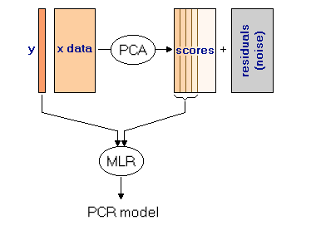
PCR
http://www.statistics4u.com/fundstat_eng/cc_pcr.html

Slide 39
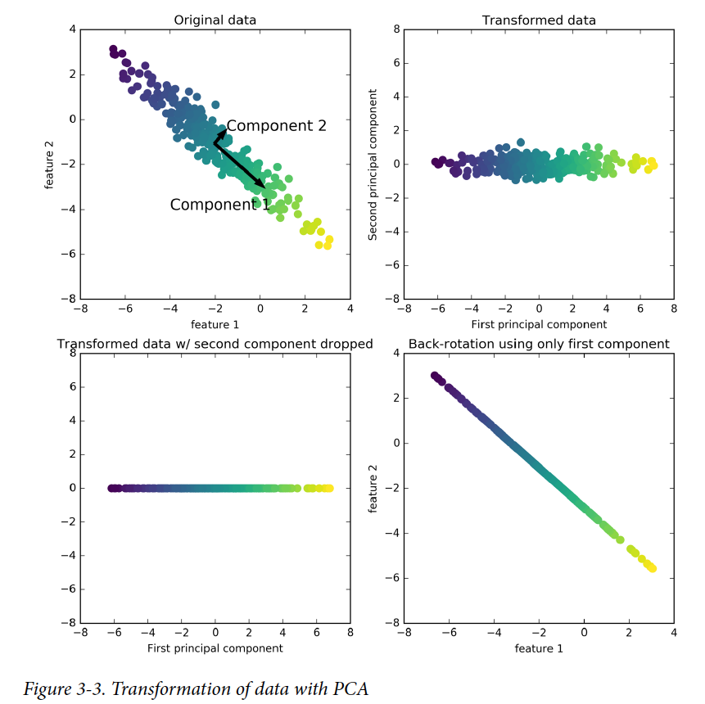
PCA Graphical Explanation
Muller, Introduction to Machine Learning with Python

Slide 40
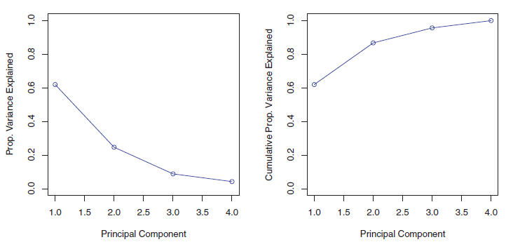
PCA Intuition – Conceptual (2 of 2)
Each successive principal component explains less of the variance in the data
A “scree” plot can be used to visualize the variance explained by the k^{th} component (or cumulative explanation of variance by the k components so far)
Slide from Dr. Brett Borghetti, AFIT/ENG CSCE 623 Statistical Machine Learning course, 2019SP

Slide 41
Python Demonstration

Slide 42
Overview
Big Picture & Introduction
Classical Selection
Best Subset Selection
Stepwise Selection (forward/backward/hybrid)
Classical Regularization (a.k.a. shrinkage)
L₁ Regularization (a.k.a. Lasso Regression)
L₂ Regularization (a.k.a. Ridge Regression)
More dimension reduction
PCA → PCR (unsupervised)
Partial Least Squares (supervised)

Slide 43
Big Picture - Concept Map

Slide 44
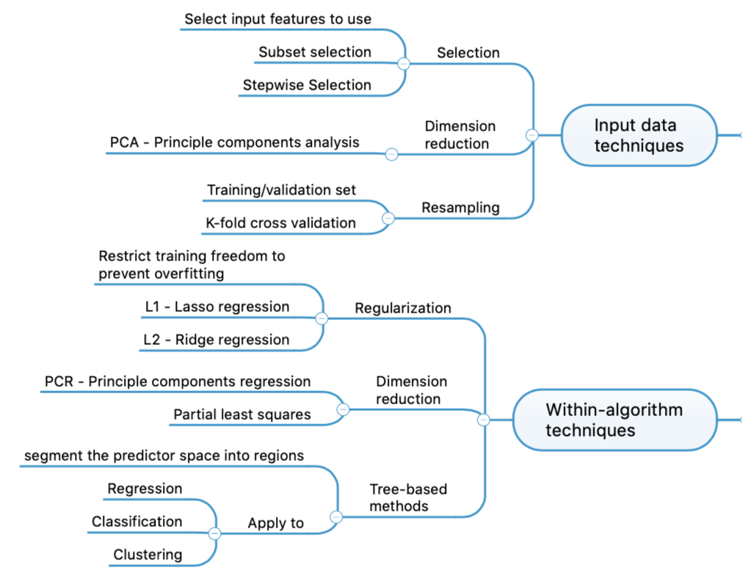
Big Picture - Concept Map

Slide 45
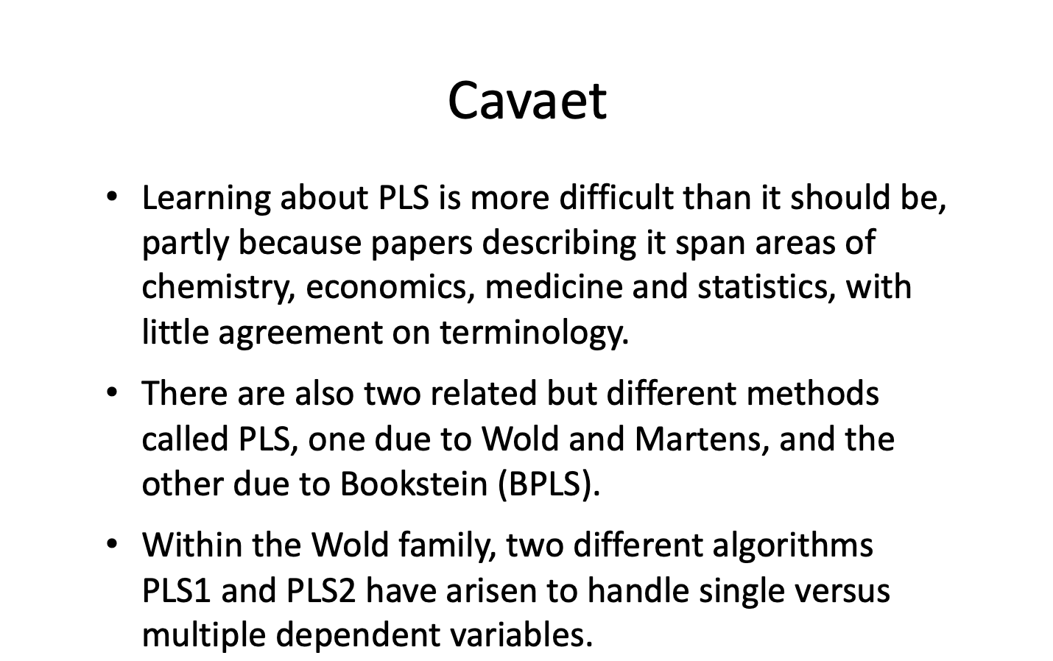
Partial Least Squares
…
Collins, B., “Partial Least Squares Regression, LPAC group meeting” (2010) http://vision.cse.psu.edu/seminars/talks/PLSpresentation.pdf

Slide 46
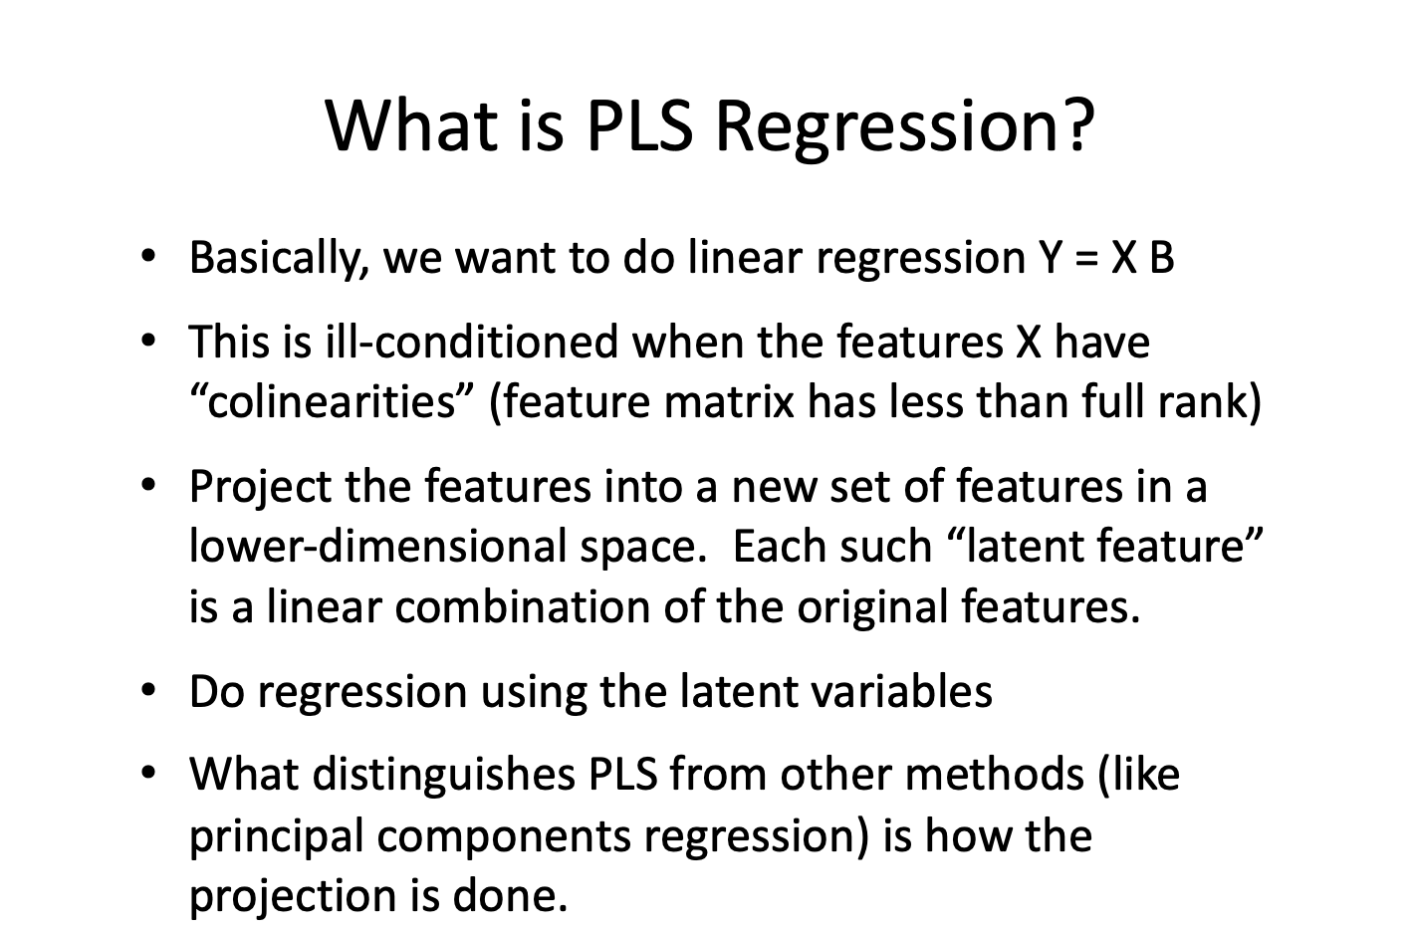
Partial Least Squares
…
Collins, B., “Partial Least Squares Regression, LPAC group meeting (2010) ”http://vision.cse.psu.edu/seminars/talks/PLSpresentation.pdf

Slide 47
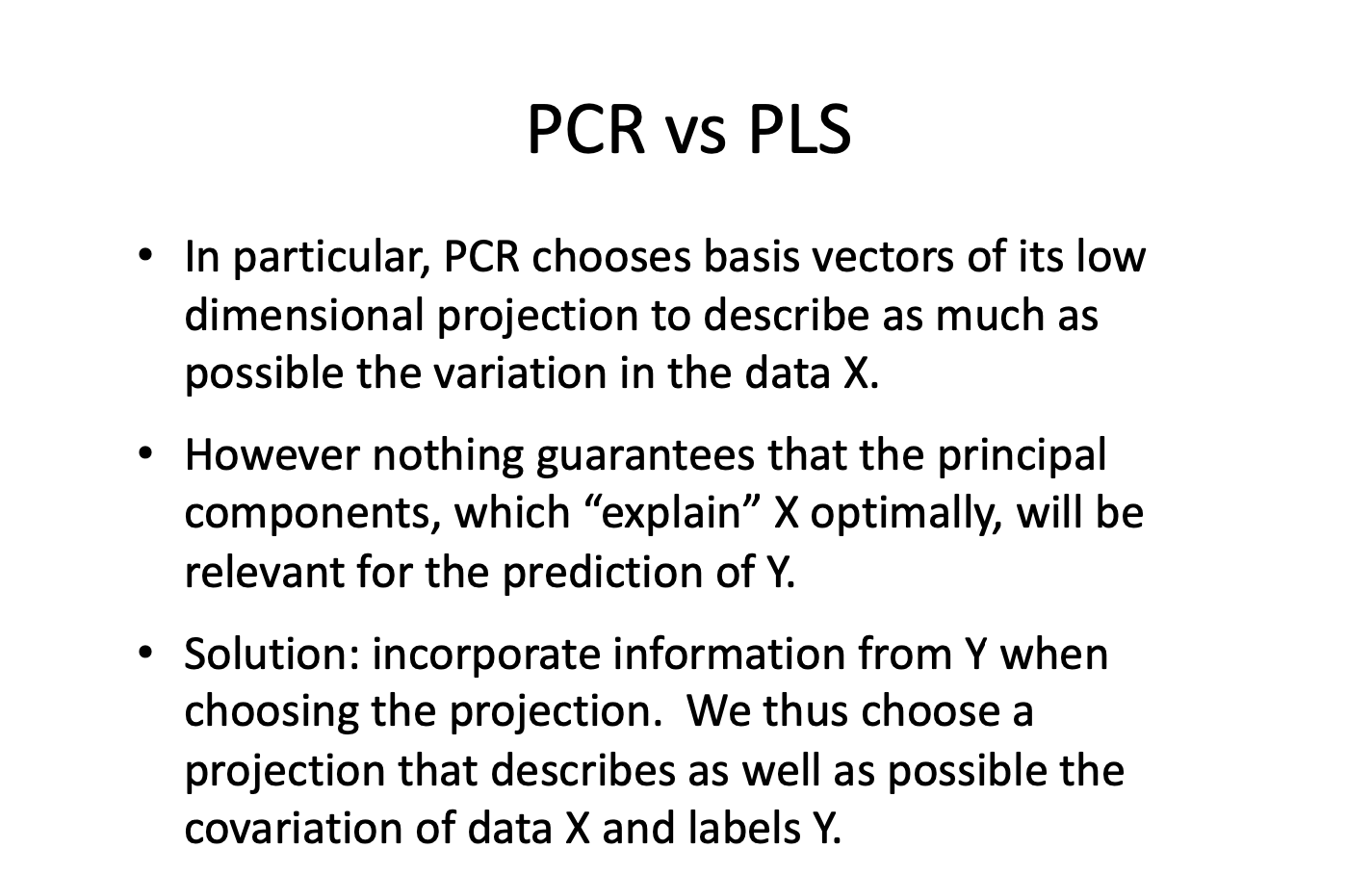
Partial Least Squares
…
Collins, B., “Partial Least Squares Regression, LPAC group meeting (2010) ”http://vision.cse.psu.edu/seminars/talks/PLSpresentation.pdf

Slide 48
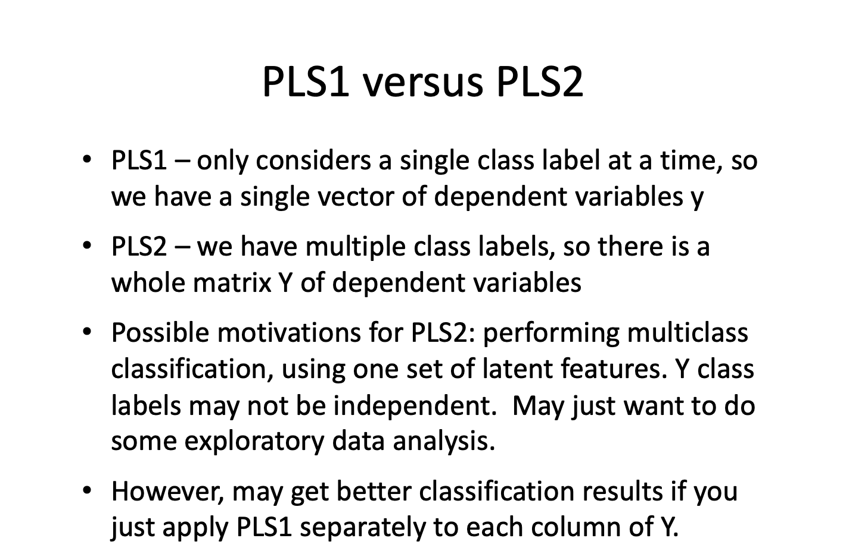
Partial Least Squares
…
Collins, B., “Partial Least Squares Regression, LPAC group meeting (2010) ”http://vision.cse.psu.edu/seminars/talks/PLSpresentation.pdf

Slide 49
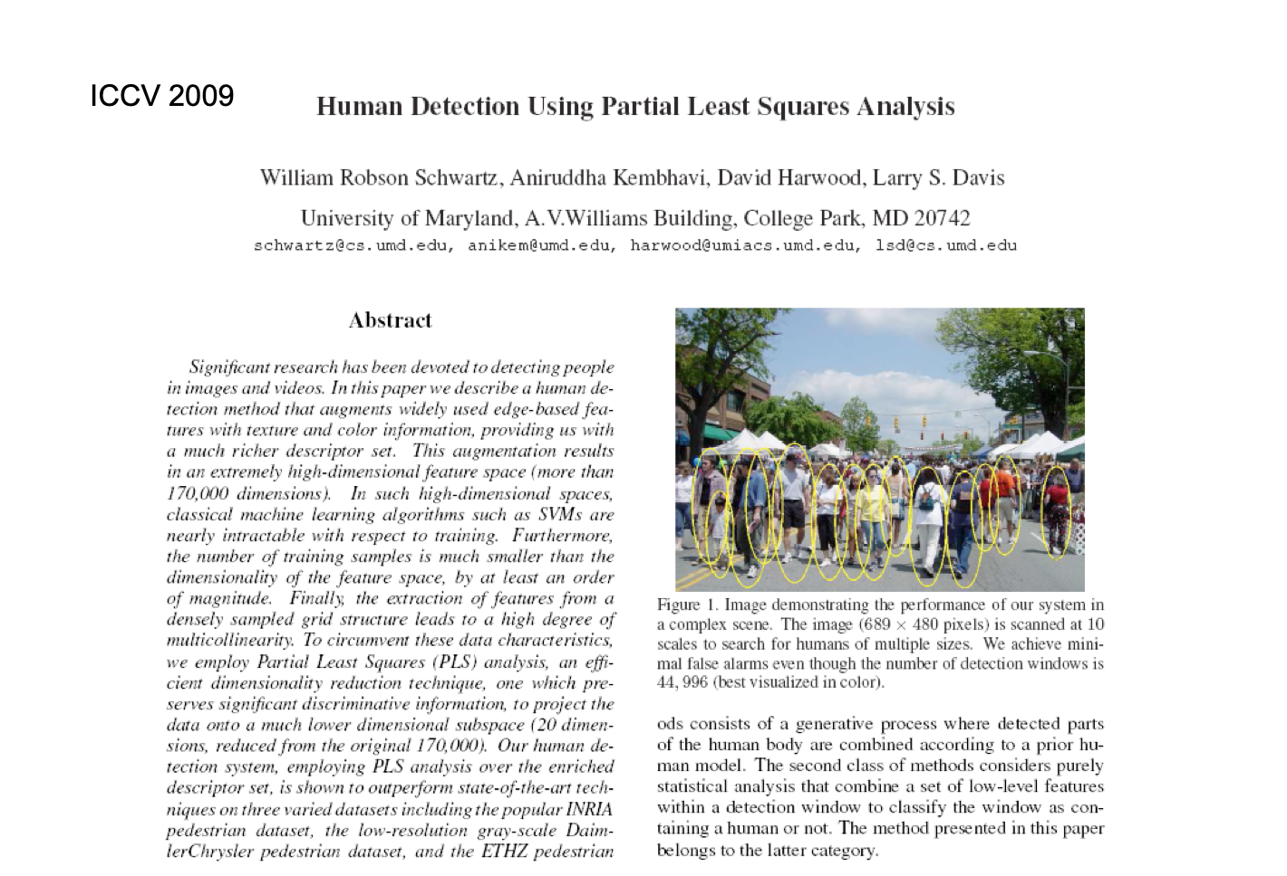
Partial Least Squares
…
Collins, B., “Partial Least Squares Regression, LPAC group meeting (2010) ”http://vision.cse.psu.edu/seminars/talks/PLSpresentation.pdf

Slide 50
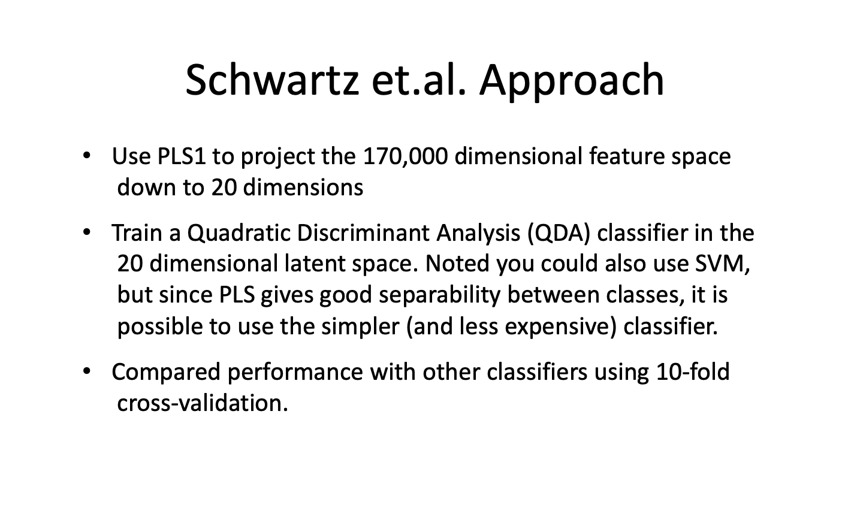
Partial Least Squares
…
Collins, B., “Partial Least Squares Regression, LPAC group meeting (2010) ”http://vision.cse.psu.edu/seminars/talks/PLSpresentation.pdf

Slide 51
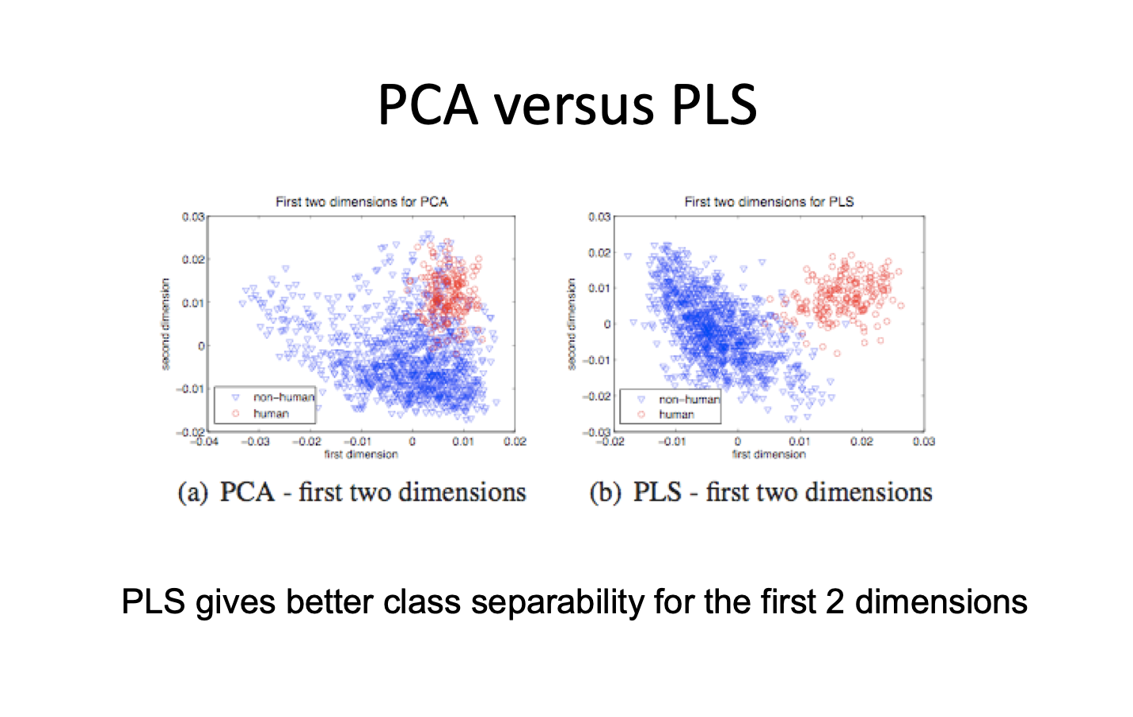
Partial Least Squares
…
Collins, B., “Partial Least Squares Regression, LPAC group meeting (2010) ”http://vision.cse.psu.edu/seminars/talks/PLSpresentation.pdf

Slide 52
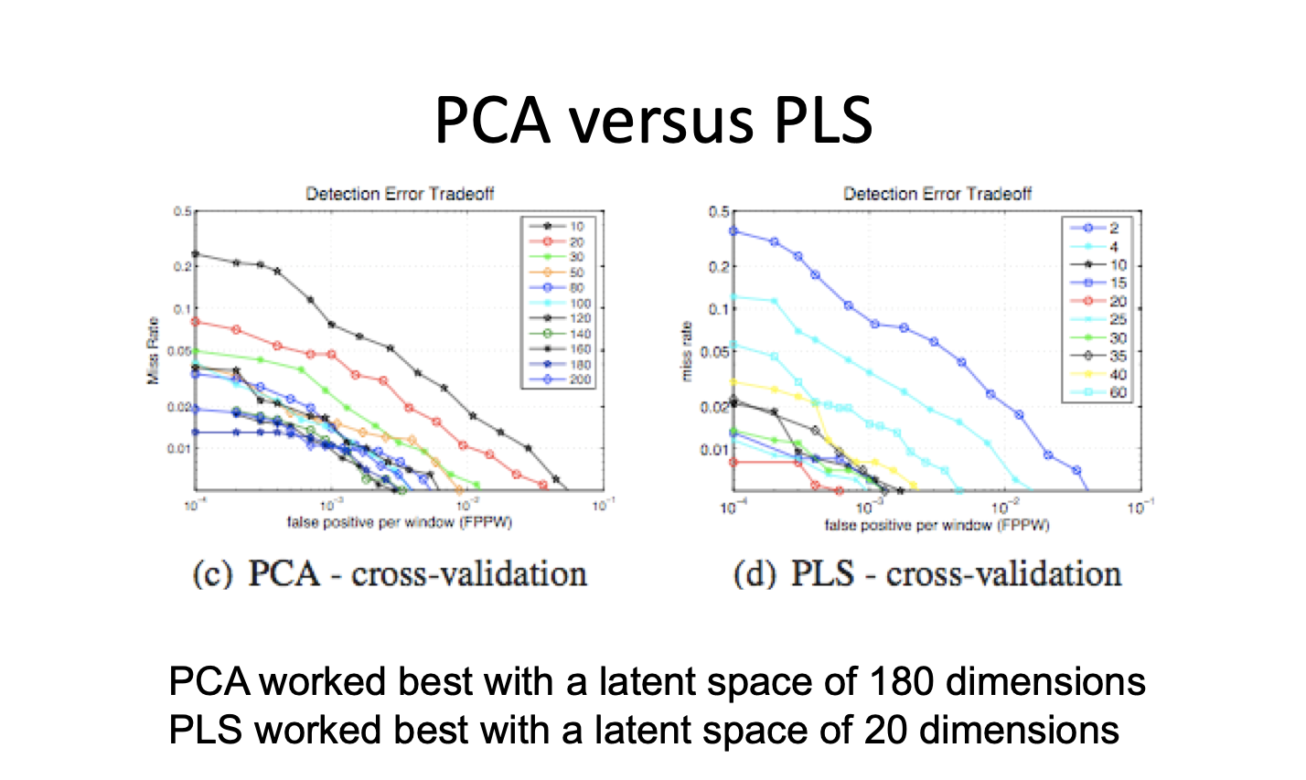
Partial Least Squares
…
Collins, B., “Partial Least Squares Regression, LPAC group meeting (2010) ”http://vision.cse.psu.edu/seminars/talks/PLSpresentation.pdf

Slide 53
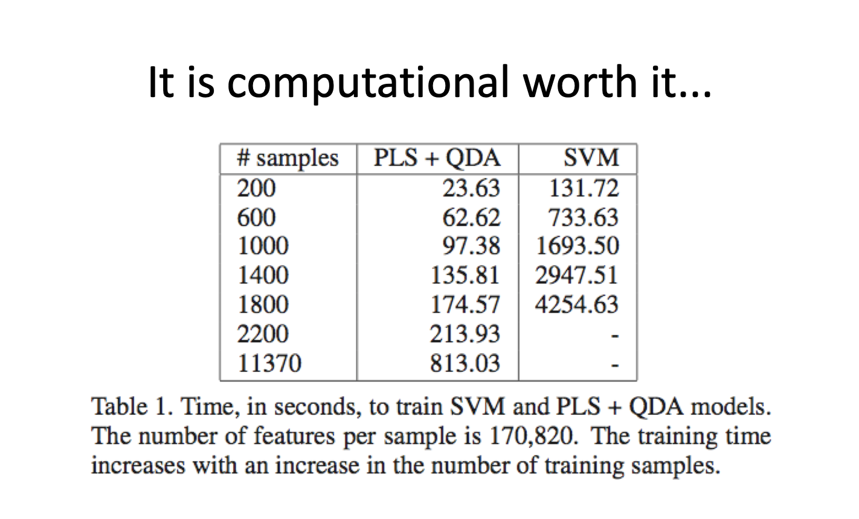
Partial Least Squares
…
Collins, B., “Partial Least Squares Regression, LPAC group meeting (2010) ”http://vision.cse.psu.edu/seminars/talks/PLSpresentation.pdf

Slide 54
Python Demonstration

